Slide 1
IoT Intrusion Detection
Using Machine Learning
Date: 29/04/2025
Presented by:
Charbel Eid (230251)
Joe Haddad (232166)
Elie El Saddy(231342)

Slide 2
01
Dataset & Class Imbalance

Slide 3
The Dataset — CIC IoT 2023
Real IoT lab environment
Dozens of CSV files, each representing a specific attack scenario
Severe imbalance: some classes had only 10–20 rows, others had 100,000+
Solution: rebuilt dataset from raw files: took ALL rare attack rows, capped well-represented classes
3.45M
Labeled Network Flows
34
Attack Categories

Slide 4
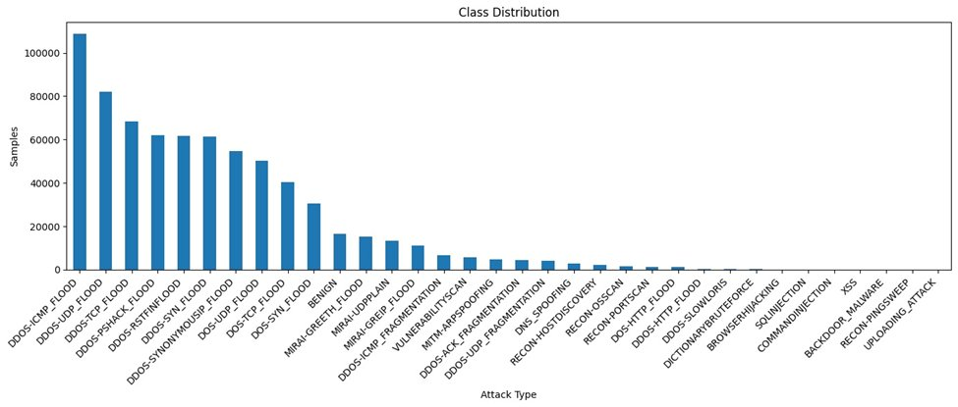
Class Distribution — Severe Imbalance Across 34 Attack Types And BENIGN
What This Shows
Top classes (DDOS-ICMP, UDP) have 100K+ samples — model learns these easily
Long tail: XSS, RECON-PINGSWEEP, UPLOADING_ATTACK near zero
BENIGN sits in the middle — not extreme but still imbalanced vs attacks
159K
1,017
Largest Class (DDoS_ICMP_FLOOD)
Smallest Class (UPLOAD_ATTACK)

Slide 5
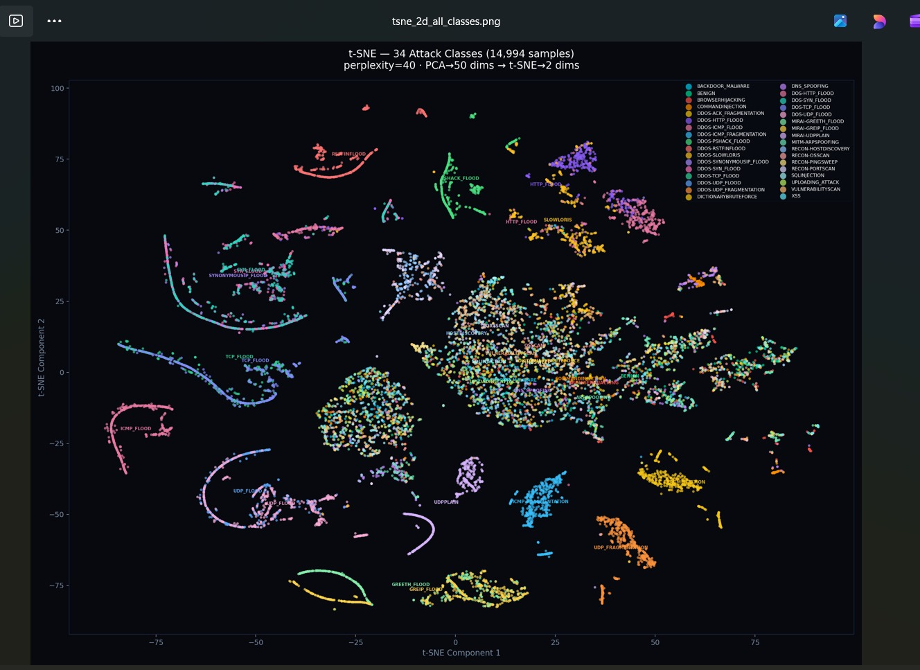
Data Visualization — t-SNE (34 Classes, 14,994 samples)

Slide 6
02
Preprocessing Pipeline

Slide 7
Feature Engineering & Data Preparation
39
Log Transformation
Impute
Scale
27
Raw Network
Features
11 Skewed
Features
Median for
Missing Values
RobustScaler
Final
Features Used
Variance-based selection removed 12 near-constant (no-information) features
Dataset split 85/15 → 2.93M training rows, 517K test rows
Test set never touched during training or tuning

Slide 8
03
Model Training & Selection

Slide 9
10 Models — From Simple to Advanced
Model | Macro F1 | Accuracy | Key Technique
Logistic Regression | 0.440 | 58.5% | Baseline, class_weight=balanced
Neural Net (Focal) | 0.541 | 67.3% | Focal Loss for hard examples
Neural Net (CE Loss) | 0.562 | 71.1% | 4-layer MLP, Batch Norm + Dropout
Random Forest | 0.586 | 76.4% | 3-fold CV, class_weight=balanced
XGBoost | 0.611 | 76.5% | GPU-accelerated
LightGBM | 0.615 | 77.0% | Leaf-wise growth, early stopping @ 830
LightGBM + SMOTE | 0.647 | 79.7% | Synthetic minority oversampling
LightGBM + SMOTE (Optuna) | 0.648 | 79.9% | Bayesian tuning, 8 trials
Stacking Ensemble | 0.660 | 81.0% | RF + XGB + LGBM + NN meta-model
Binary LightGBM | 0.973 | 94.9% | Threshold-optimized, BENIGN vs ATTACK

Slide 10
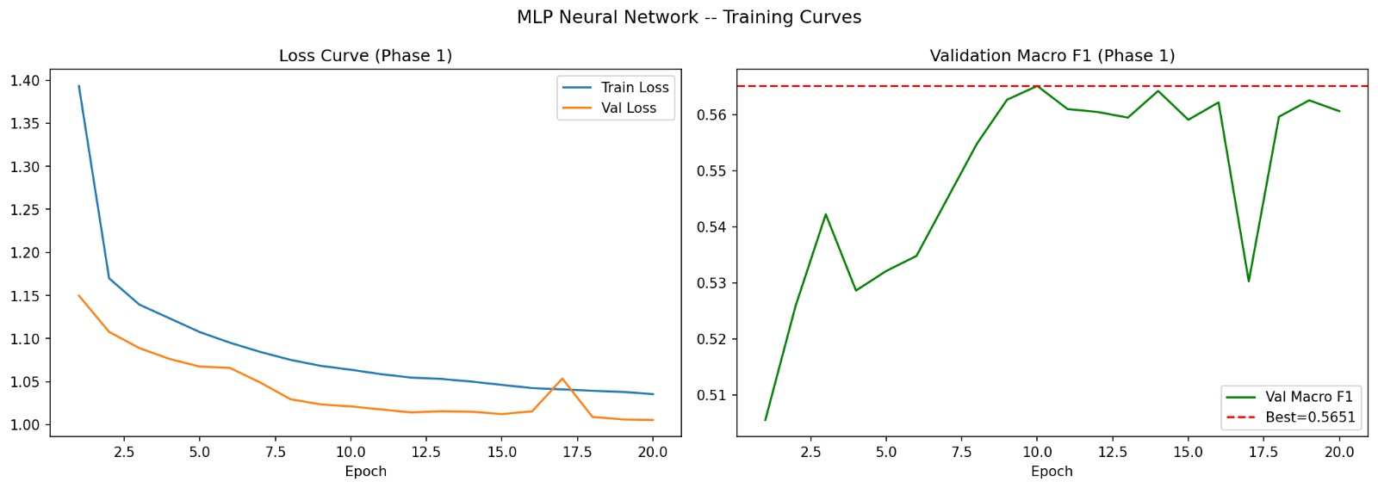
Neural Network — MLP Training Curves
Loss converges smoothly — no overfitting. Best Val Macro F1 = 0.5651 (Phase 1). Neural networks underperform tree models on this tabular dataset.

Slide 11
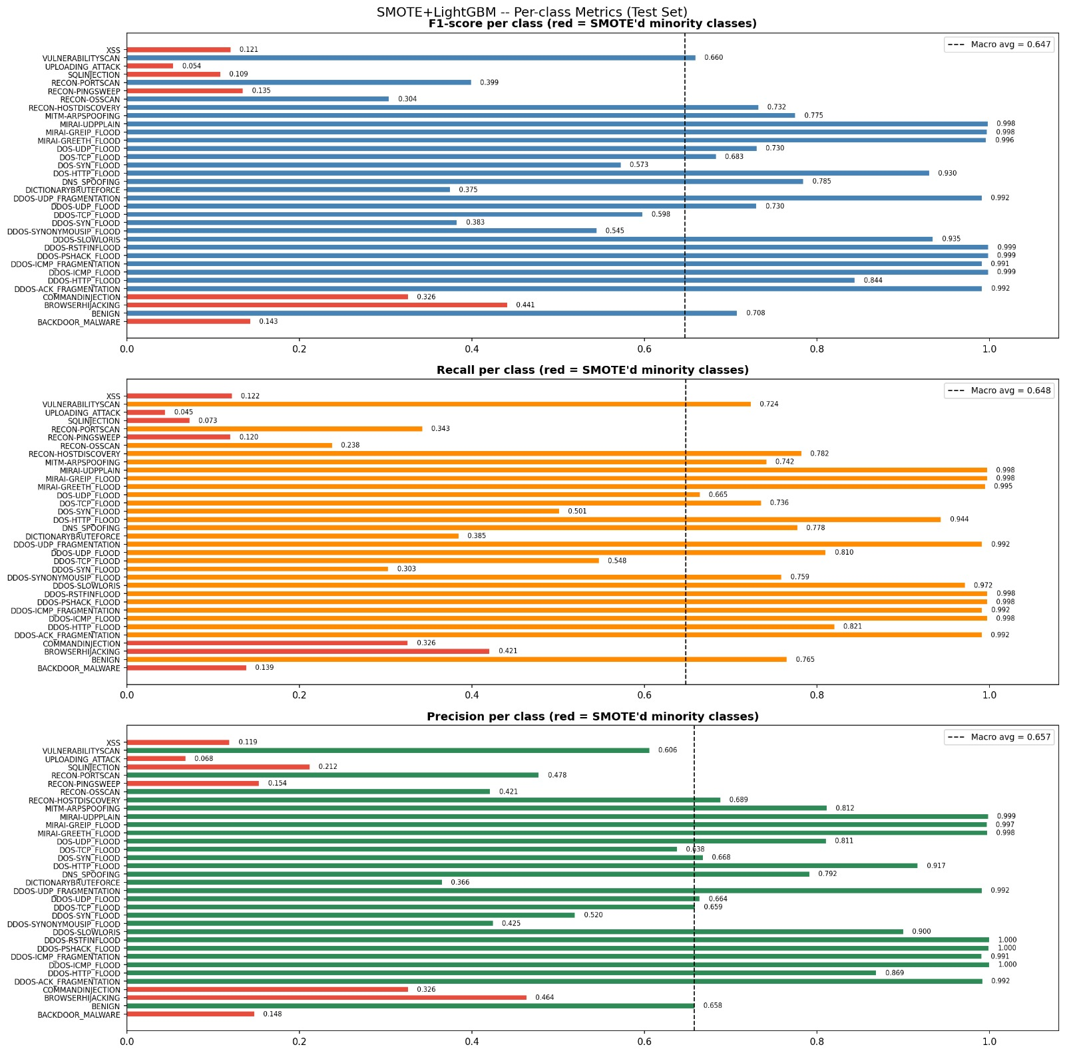
SMOTE + LightGBM — Per-Class Performance
Key Observations
Red bars = SMOTE-augmented minority classes
Flood-type attacks: F1 ≈ 0.99
Rare attacks (XSS, SQLI, UPLOAD): F1 < 0.15 — insufficient training data
Macro avg F1 = 0.647 pulled down by rare classes
➔ This is a data problem, not a model problem

Slide 12
04
Results & Comparison

Slide 13
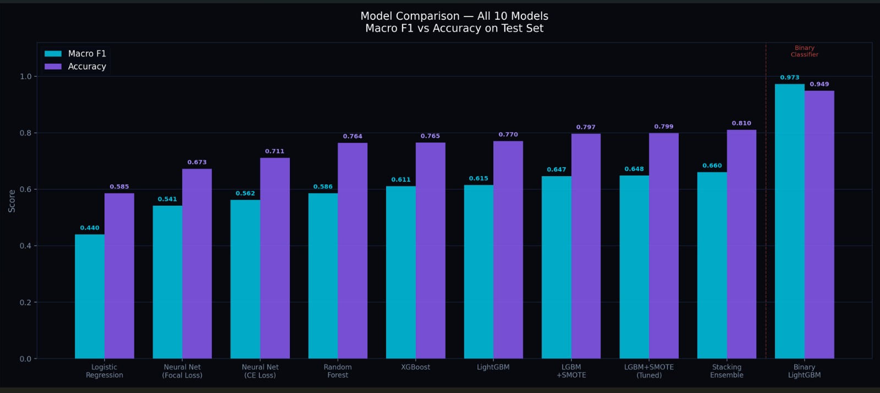
All 10 Models — Macro F1 vs Accuracy
Binary LightGBM dramatically outperforms all multiclass models: F1 = 0.973, Acc = 0.949

Slide 14
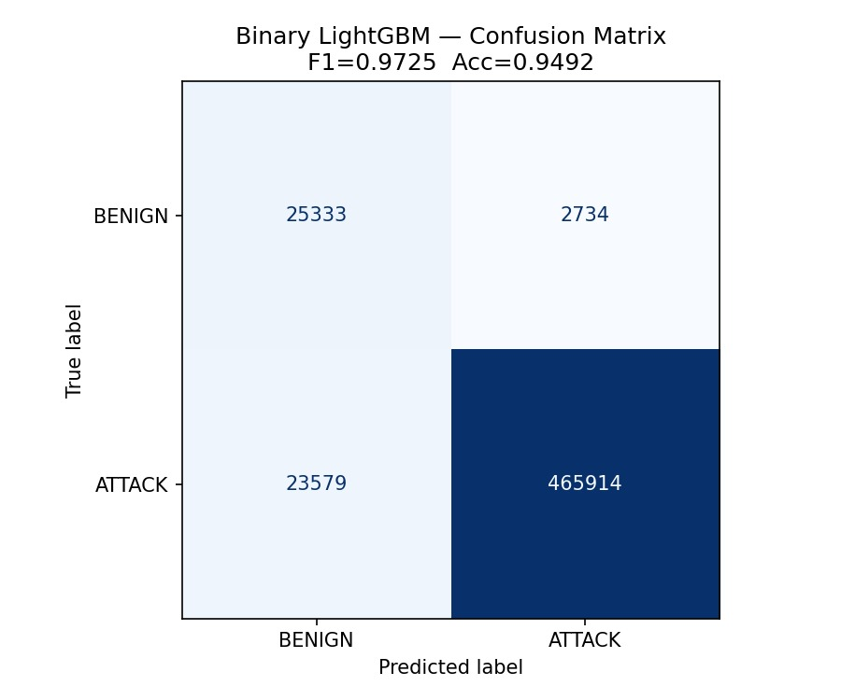
Binary LightGBM — Confusion Matrix
0.9725
0.9492
F1 Score
Accuracy
0.9833
9.74%
ROC-AUC
False Positive Rate
4.82%
False Negative Rate — catches 95.2% of attacks
Threshold optimized: maximize attack recall while keeping FPR < 10%

Slide 15
05
FP vs FN Trade-off

Slide 16
False Positives vs False Negatives
False Positive
False Negative
Normal traffic flagged as attack
Real attack missed entirely
Alert fatigue for analysts
Wastes investigation time
Annoying but not dangerous
Constrained to < 10% (9.74%)
Dangerous — attack goes undetected
Data breach or system compromise
Much higher cost than FP
Minimized to 4.82% → 95.2% catch rate
Conscious design trade-off: we accepted more false alarms to minimize missed attacks

Slide 17
06
API & Deployment

Slide 18
Real-Time REST API — FastAPI
Endpoints
Drift Monitoring
Individual endpoint per model (9 total)
/predict/all — runs all models simultaneously
Returns predictions + majority vote
Low-latency inference on incoming network flows
Rolling window of last 500 predictions
Feature drift — detected via Z-scores
Class mix drift — shift in attack distribution
Alert rate spikes — sudden surge detection
Architecture: Real network flow → Feature extraction (27 features) → Preprocessing → FastAPI → Model ensemble → Binary/Multiclass prediction

Slide 19
07
Conclusion

Slide 20
Key Takeaways
🔒
Complete End-to-End IDS
From raw CSV files to a deployed REST API with drift monitoring
⚖️
Imbalance Was the Core Challenge
SMOTE was the single most impactful technique across all experiments
📊
Multiclass: Data Bottleneck
Rare classes (<1,000 samples) cannot be reliably learned — a data problem, not a model problem

